Slide 1
WEB DESIGN

Slide 2




T E C H N O L O G I E S

Slide 3
<!DOCTYPE html>
<html>
<head>
<title>Website</title>
</head>
<body>
<p>Paragraph</p>
</body>
</html>
Skills gain
Web Design
Web Accessibility
Html5

Slide 4
P{ Color : Red; font-family: "Helvetica Neue", Helvetica, Arial; }
The web today is almost unrecognizable from the early days of white pages with lists of blue links.
Now, sites are designed with complex layouts, unique fonts, and customized color schemes.

Slide 5
Ability to Incorporate Interactivity Is a must now In Websites
Document Object Model (DOM) is used by JavaScript to identify and modify specific parts of your page
<script>
alert("Hello, world!_");
prompt("enter your name:");
document.write("<h1>Time to learn javascript</h1>");
</script>

Slide 6

Build responsive, mobile-first projects on the web with the world’s most popular front-end component library.
Responsive Design is a key component to web design today.
It touches on user experience, graphical design, and coding
It can also affect SEO
open source toolkit for developing with HTML, CSS, & JS

Slide 7
“Responsive” options
• Responsive Web Design (RWD) – fluid measurements, flexible grids, and varying CSS rules
• Adaptive Design (dynamic serving) – returns one of multiple versions of a page based on the type of device
• Separate Mobile Site (.m) - a separate page URL for the mobile site

Slide 8


Slide 9

Don’t deal with Colors Could be little different in actual Content Similar to actual look of website

Slide 10
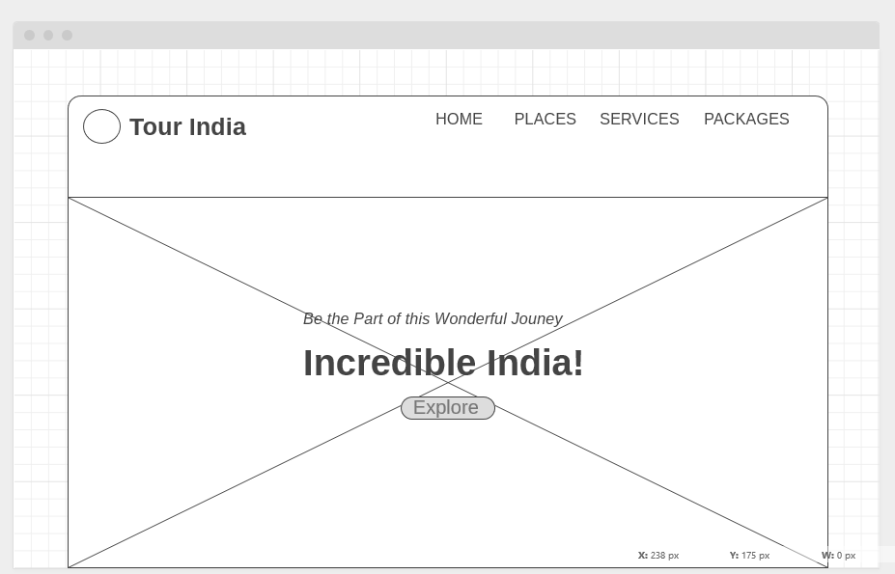
Wireframe Look

Slide 11
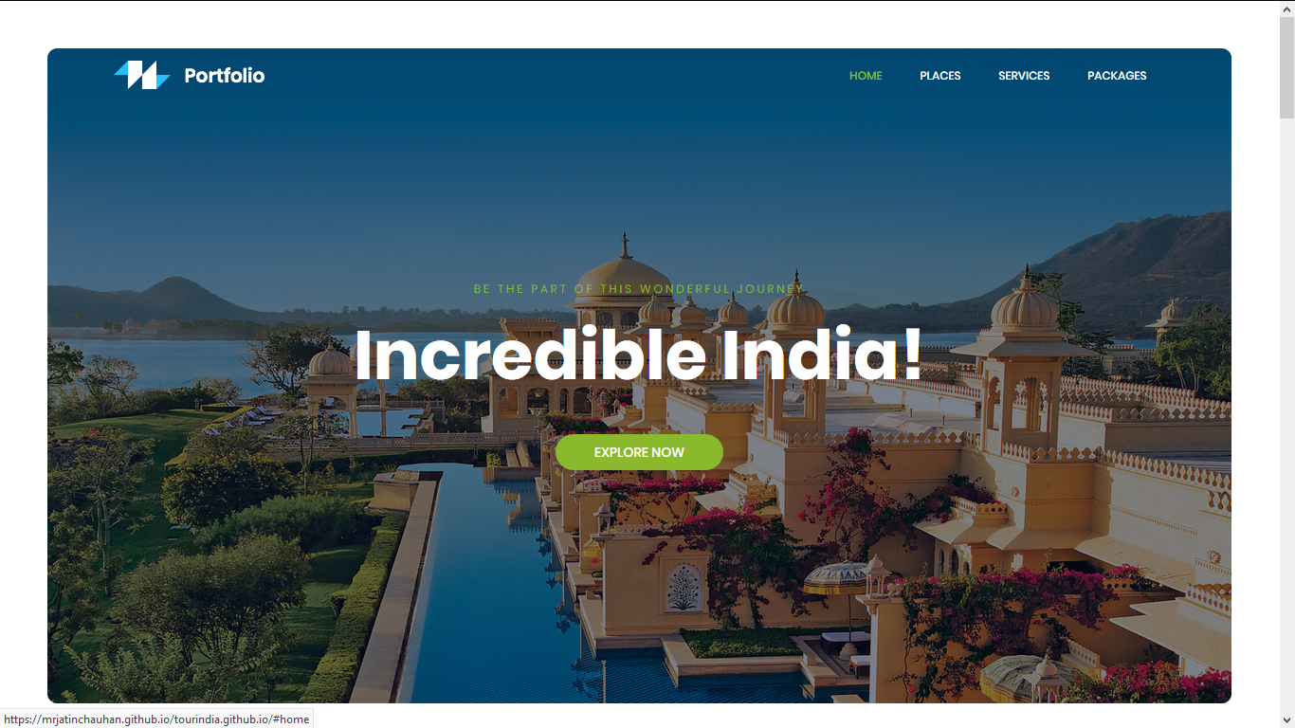
Actual Website

Slide 12
<script> prompt(“Thank You"); </script>

